Slide 1
CIS017-1 – Computer Systems Structure
CIS095-1 – Databases and Computer Networking
Lecture – Relational DBMS and Entity Relationship Modelling (ERM)

Slide 2

Data Management Overview
Card indexes
Separate systems
  separate files/programs for each application
  (payroll, personnel, accounts, ….)
CAUSES
  Duplication
  Inconsistency
  Redundancy
  Lack of integration and control

Slide 3

Database System
  Involvement of:
    Hardware
    Software
    Humans
“A shared collection of logically related data (and a description of this data), designed to meet the information needs of an organisation.” (Connolly & Begg 2002)
Capable of storing and displaying data under request
  3-fold Function:
    Input
    Interrogate
    Display Matches

Slide 4
Database Management System (DBMS)
Report
Application
1
Application
2
Enquiry
Retrieve
Update
Delete
Database Management System
Control
Security
Integrity
DATA
STORE
Data is controlled by a Database Management System

Slide 5
DBMS Functions
Data Storage, retrieval and update
A user accessible catalogue
Transaction support
Services:
  Concurrency control
  Recovery
  Authorisation
  Data communication
  Data integrity
  Data independency
  Utility

Slide 6
DBMS Advantages
Reduces:
Duplication
Cost and complexity of change
Input costs
Enhances:
Currency and consistency
Flexibility, Accessibility
Ease of update

Slide 7
Types of Database Management Systems
Hierarchical
Network
Relational (R-DBMS)
Object-Oriented (O-ODBMS)
Hybrid (Object-Relational)
Multimedia
Document / Electronic Document Management
Intelligent

Slide 8
Relational Database (RD)
A model proposed by E. F. Codd (1970)
A great strength of the RD model is its simple logical structure
“A data model that represents data in the form of tables or relations” (Hoffer 1999)
“A table is in more traditional parlance, a file. A table has rows and columns, which, more traditionally, are known as records and fields/attributes” (Chester & Athwall 2002)
Each relation has a name and is made up of named attributes/columns of data. Each row contains one value per attribute

Slide 9
Relational Database (RD)
No duplicated rows
No order to the rows (top to bottom)
No order to the columns (left to right)
Each attribute value atomic,
each cell contains one
and only one data value

Slide 10
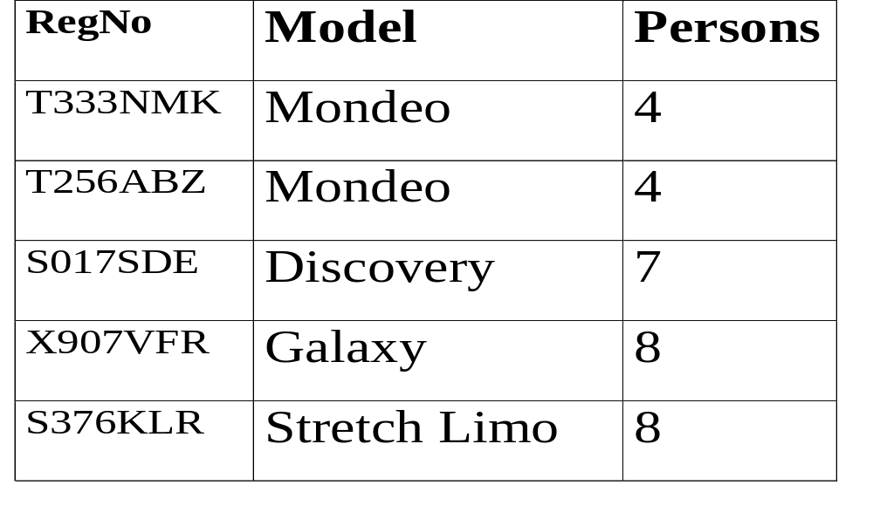
Example of Relational Table
mondeo
mondeo
galaxy

Slide 11
Terminology
Relation a table with columns and rows
Tuple a row of a relation
Attribute a named column of a relation
Domain a set of allowable values for 1 or more attributes
Degree the number of attributes it contains
Cardinality the number of rows/tuples it contains
RD a collection of normalised relations with distinct relation names

Slide 12
attributes
Domain = 4, 7, 8
Cardinality = 5
Degree = 3

Slide 13
Development Process
requirements
Requirements
Conceptual
data modelling
Analyse Data
ERM
Develop Data Model
Normalise Data
Database design
Reconcile
Table Definitions
Database build
Physical Design
Build Database

Slide 14
…ERM components
Entities
  The things of significance about which information needs to be known or held
Relationships
  How the things of significance are related
Attributes
  The specific information which need to be held

Slide 15
Entity and Attributes diagramming conventions
ENTITY:
  Shown as rectangle with name in top section
  Box with any dimensions
  Singular, unique name
  Name in upper case
  Optional synonym name in parentheses
Attributes:
  listed in bottom section
  Name in lower case
  Unique entity ID underlined
CUSTOMER
(Client)
CUSTOMER
Customer#
Customer Name
Customer Address
Spending limit

Slide 16
Identification of Entities
There must be a facility to check in goods on arrival at the warehouse, and record their location. As they pass through the processing stages in the warehouse, the system should track progress. The system should record full information about each package…..
Examine the nouns. Are they things of significance?

Slide 17
…example…..
You are managing the human resources department for a large company. You need to keep information about each of your company’s employees including first & last name, job, hire date & salary. Every employee is assigned to a unique employee number.
EMPLOYEE
# Employee Number
First Name
Last Name
Job
Hire Date
Salary

Slide 18
…tips…..
Follow the steps below to identify and model entities from a set of interview notes:
  Examine the nouns. Are they things of significance?
  Name each entity.
  Is there information of interest about the entity that the business needs to hold?
  Name each attribute.
  Write a description of it. “an employee has significance as a paid worker at the company’.
  Diagram each entity and few of its attributes.

Slide 19
…exercise 1…..
Identify and model the entities & attributes from the following set of interview notes:
“Andrew is the manager of Luton’s training company (LTC) that provides instructor-led courses in management techniques. LTC teaches many courses, each of which has a code, a name and a fee. Managing Information & Internet and Web Technology are 2 of its more popular courses. Courses vary in length from 1 to 5 days. An instructor can teach several courses. Nik & Fiaz are two of its teachers. LTC tracks each instructor’s name & phone number. Each course is taught by only one instructor. LTC creates a course and then lines up an instructor. The students can take several courses over time. Maria from Bank plc took every course LTC offers. LTC tracks each student’s name and phone number. Some off its students and instructors do not give their phone number”.

Slide 20
RELATIONSHIPS
A relationship is two-directional, significant association between two entities (or between an entity and itself).
Example:
  Each COURSE may be taught by one and only one INSTRUCTOR.
  Each INSTRUCTOR may be assigned to one or more COURSEs.
COURSE
Code
Name
Fee
Duration
INSTRUCTOR
(Teacher)
Name
Phone number
STUDENT
Name
Phone number

Slide 21
RELATIONSHIPS
Each direction of a relationship has:
        A name
        An optionality
        A degree or cardinality
Example:
  Name: taught by or assigned to
  Optionality: either must be or may be
  Degree/cardinality: either one and only one or one or more
COURSE
Code
Name
Fee
Duration
STUDENT
Name
Phone number
INSTRUCTOR
(Teacher)
Name
Phone number

Slide 22
…example…..
One
Single line
Many
Crows foot line
Optional
Dashed line
Mandatory
Solid line

Slide 23
…tips to identify cardinality….
First read a relationship in one direction, and then read the relationship in the other direction.
Each PAYCHECK must be for one and only one EMPLOYEE
Each EMPLOYEE may be the receiver of one or more PAYCHECKs
PAYCHECK
for
EMPLOYEE
the
receiver
of

Slide 24
…exercise 2….
Write the relationship sentences for the following ERM:
ORDER
Issued for
ITEM
Bought via
Originated by
Stored in
the
originator of
the
repository of
CUSTOMER
WAREHOUSE

Slide 25
Using a Relationship Matrix (RM)
A RM shows if and how each entity is related to another entity
If it related then the name of that relationship is shown in the intersection box
If it is not related then a long dash line is shown in the intersection box
CUSTOMER
ITEM
ORDER
WAREHOUSE
CUSTOMER
_____
_____
The
originator of
_____
ITEM
_____
_____
Bought via
Stored in
ORDER
Originated by
Issued for
_____
_____
WAREHOUSE
_____
The
repository of
_____
_____

Slide 26
…Exercise 3…..
Draw a complete ERM using the incomplete version drawn for the exercise 1
  Steps:
    Write the relationship sentences
    Map relationships to the Matrix
    Determine Cardinality
    Determine Optionality
    Draw the complete ERM

Slide 27
..part solution for exercise 1..
Descriptions:
  A COURSE has significance as a training event offered by the LTC. For example, Managing Information & Internet and Web Technology
  An INSTRUCTOR has significance as a teacher of one or more COURSEs. For example, Nik & Fiaz.
A STUDENT has significance as a participant in one or more COURSEs. For example, Maria
COURSE
Code
Name
Fee
Duration
STUDENT
Name
Phone number
INSTRUCTOR
(TEACHER)
Name
Phone number

Slide 28
…solution for exercise 2….
Each ORDER must be issued for one or more ITEMs
Each ITEM may be bought via one or more ORDERs
Each ORDER must be originated by one and only one CUSTOMER
Each CUSTOMER may be the originator of one or more ORDERs
Each ITEM must be stored in one and only one WAREHOUSE
Each WAREHOUSE may be the repository for one or more ITEMs

